Slide 1

Year 8 Information Evening

Slide 2

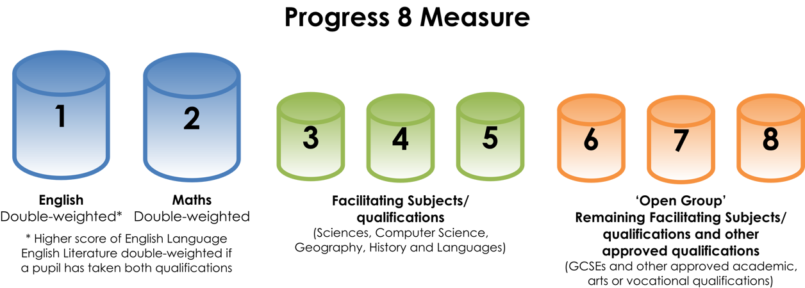
How is examination success currently judged?

Slide 3
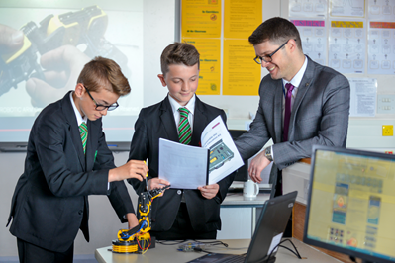
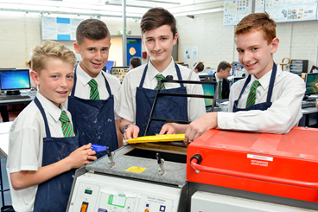
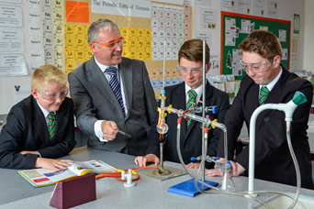
Which subjects do I have to take at Key Stage 4?
The Core Programme is taken by every student. So you will study:
· English (Language and Literature)
· Mathematics
· Science (2 GCSE equivalent)
· ICT
· PE (Non-examinable)
· RE (Non-examinable)
· Careers (including Citizenship, Work Related Learning & Enterprise Education).

Slide 4
Do I get any choice in my subjects?
Yes, but within some constraints.
All students will have to choose at least one subject from the following list to ensure that they meet progress 8 requirements:
· A Modern Foreign Language
· Geography
· History
· Separate Sciences (Topping up to 3 Science GCSEs in total)
· Computer Science

Slide 5

What is the English Baccalaureate?
To achieve the Ebacc, a student must attain grade 5 or above at GCSE in all of the following subjects:
· A Modern Foreign Language
· Geography or History
· Any 2 Sciences (including Computer Science)
· English (Language or Literature)
· Mathematics
Notes:
The Government are actively promoting the English Baccalaureate (Ebacc), it is increasingly likely that employers in certain sectors will look for prospective employees to have completed a full Ebacc.
To achieve this, a student must achieve grade 5 or above at GCSE in all the following subjects:

Slide 6
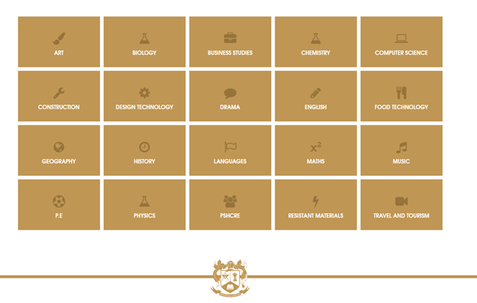
Why am I having to choose my options in Year 8?
In short, to give you more choice.
By starting Key Stage 4 in Year 9, we can allow you four option choices instead of three.
This means that you can complete the full Ebacc and still have some freedom of choice.

Slide 7
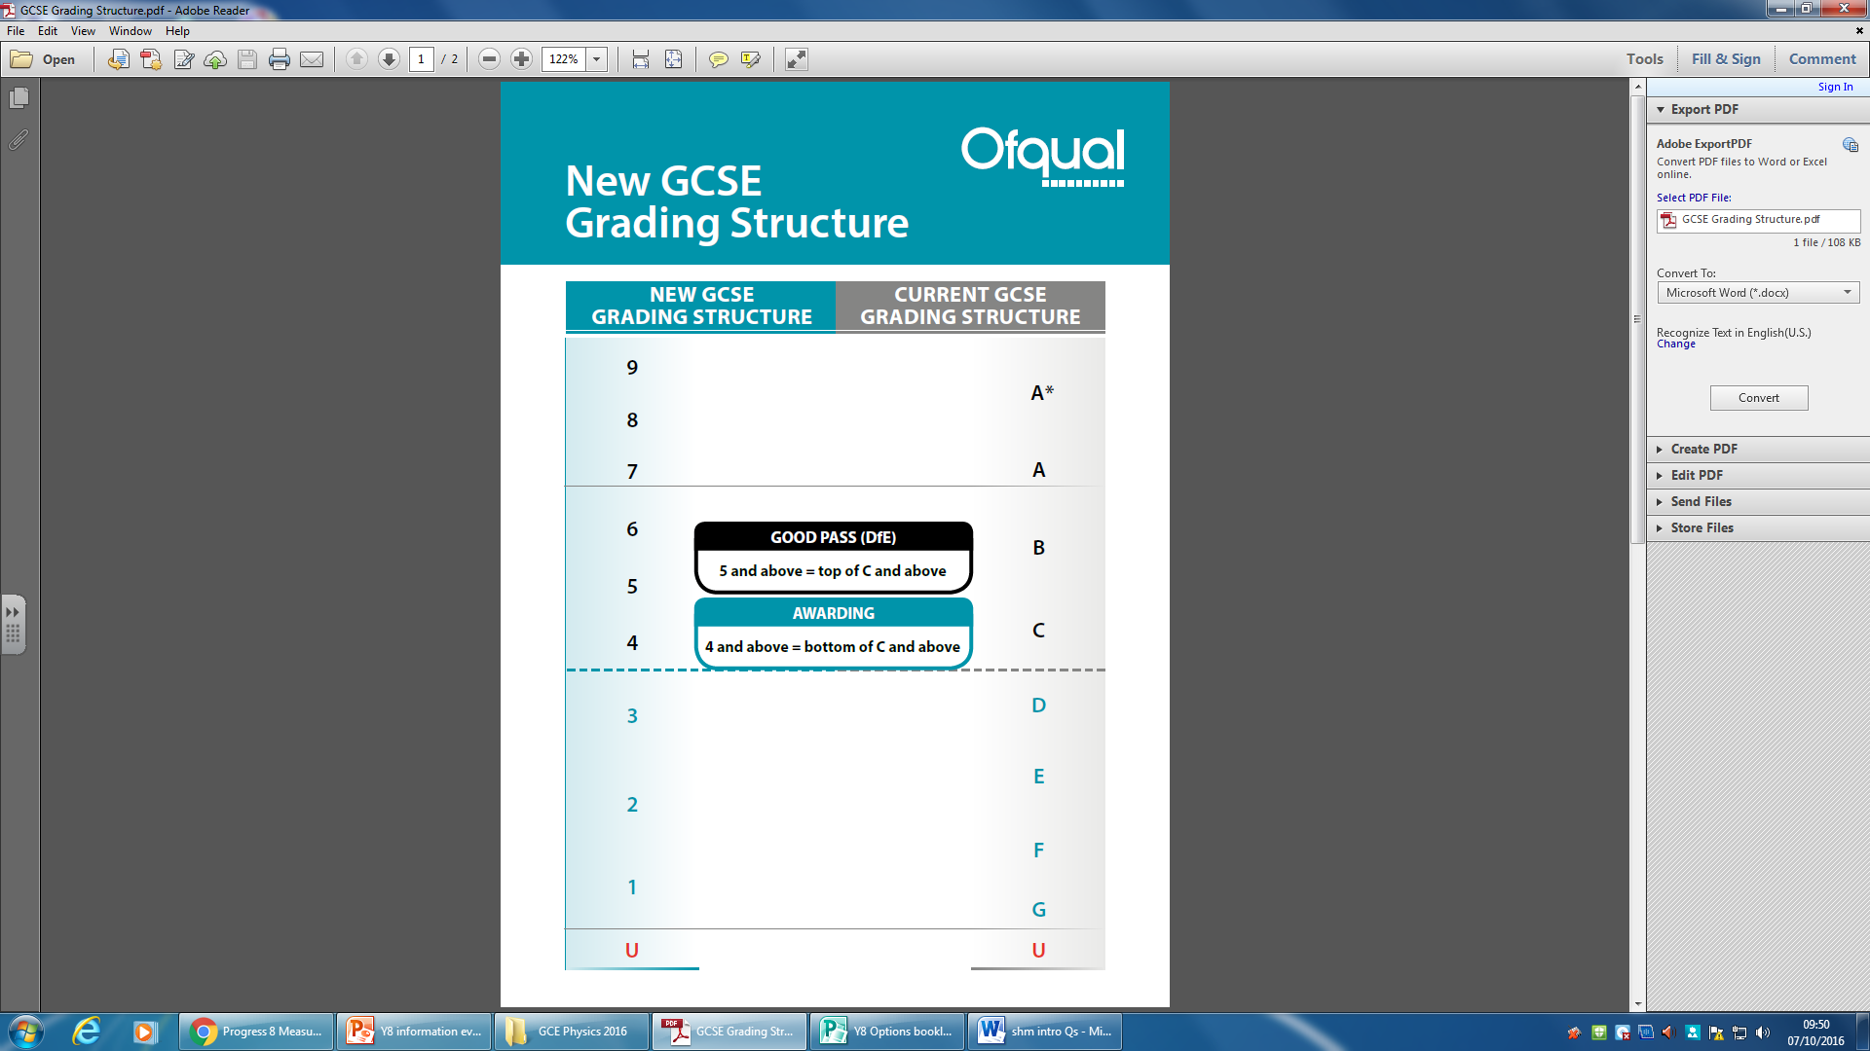
How will I know which subjects to choose?
Advice from subject teachers
Careers guidance in school
Progress reports
Discussion at home

Slide 8

When do I finalise my choices?
Initial thoughts before Christmas
Options evening – Tuesday 23rd January
Parents evening – Thursday 1st February
Options form hand in – Friday 2nd February

