Slide 1
TRANSITION TO SECONDARY SCHOOL
Learning objectives
Learning outcomes
We are learning about the transition from primary to secondary school and how to manage the changes that can arise.
By the end of the lesson you will be able to…
Identify the differences between primary and secondary school
Describe how it might feel to move to secondary school
Explain different ways of managing change.
Key Vocabulary
Change, new, relationships, transition, routine, unknown,
difference, support and guidance

Slide 2

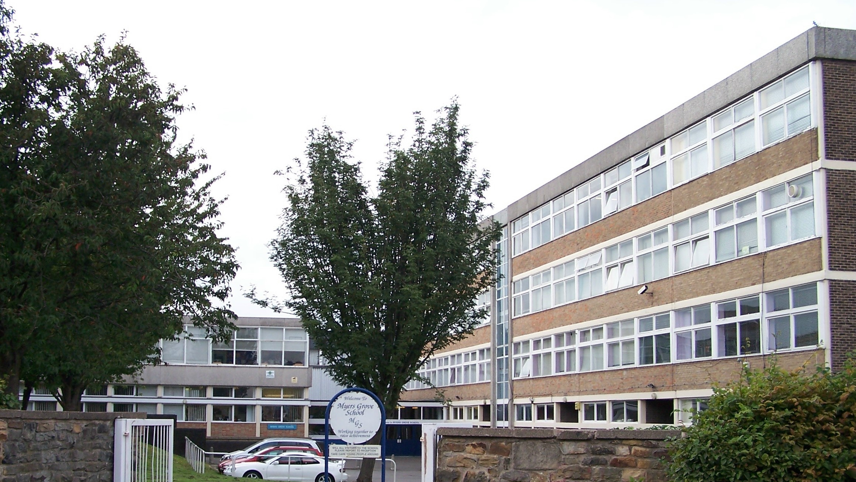
TRANSITION TO SECONDARY SCHOOL
Create a list of words you associate with the picture below.
Notes:
Ask pupils to create a list of words they associate with the picture of a secondary school.
Pupils can complete this initial activity on their own, in pairs or in groups. They can either write down or discuss their ideas.

Slide 3
TRANSITION TO SECONDARY SCHOOL
SELF ASSESSMENT
I can identify the differences between primary
and secondary school.
I can describe how it might feel to move to secondary school.
I can explain some ways to manage this change.
0
10
NOT CONFIDENT
EXTREMELY CONFIDENT
Notes:
Pupils should respond to the three baseline statements on a confidence scale: 0 = not confident, 10 = extremely confident.

Slide 4

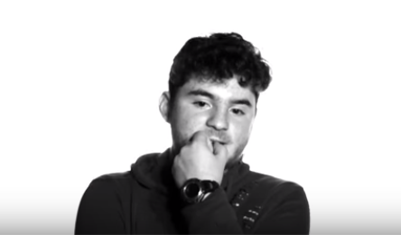
TRANSITION TO SECONDARY SCHOOL
MAKING THE MOVE
Watch the first part of the video
Let's talk about change!
Questions for discussion:
What will the similarities be between primary and secondary school?
What will the differences be between primary and secondary school?
What are the most important things a Year 6 pupil needs to know about secondary school? (e.g. structure of the day, how many teachers will they have, how many people in a class, etc.)
Notes:
Show the first part of the video clip (00:00-00:45) about change.
Explain to pupils that in this lesson they will be exploring change in relation to moving on to secondary school - what they think the transition to secondary school will be like, how it will feel and what they can do to prepare.
Ask the class to discuss the questions on the slide.

Slide 5

TRANSITION TO SECONDARY SCHOOL
MAKING THE MOVE: HEAD
What might new Year 7 pupils be thinking
on their first day of school?
Notes:
This activity can be done in pairs or small groups. Give pupils an A4/A3 sheet and ask them to draw a stick person with a head, heart and hands.
Ask pupils to write down thoughts near the head showing what new Year 7 pupils might be thinking on their first day
It may be preferable to place students in mixed ability groups rather than facilitating yourself in order to encourage as much student-led work as possible.

Slide 6

TRANSITION TO SECONDARY SCHOOL
MAKING THE MOVE: HEART
How might it feel to start a new school?
Notes:
Ask pupils what feelings pupils might have about starting secondary school, and add their ideas near the heart on their sheet.

Slide 7

TRANSITION TO SECONDARY SCHOOL
CHANGES
Watch the second part of the video
Let's talk about change!
Questions for discussion:
What do you think are the most exciting things about starting secondary school?
What do you think someone might be nervous about when starting secondary school?
How do you think a person’s feelings might change over the first year at secondary school?
Notes:
Show the second part of the video about change (1:20-3:05).
Ask the class to discuss the questions on the slide.

Slide 8
TRANSITION TO SECONDARY SCHOOL
CHANGES
Scenarios/Viewpoints
‘I can’t wait to join the clubs. I love sports!’
‘Sometimes I think I could do better in school. I’m looking forward to a new start.’
‘My new school will be a bus ride away. I hope I don’t get lost.’
‘I’m going to a different school than most of my friends but my sister loves her new friends from secondary school, so maybe this will be the same for me.’
‘I’ve heard you have lots of teachers and the work is
much harder.’
Notes:
Show pupils the five scenarios/viewpoints about starting secondary school on this slide, and the list of strategies to manage change on the next slide. Ask them to match up suitable strategies to each of the viewpoints (these can be projected on the board or printed out).
This can be done in pairs or small groups. Different groups could be given different scenarios.
If this text size is too small for your class, we recommend printing out the viewpoints and strategies as a handout.

Slide 9
TRANSITION TO SECONDARY SCHOOL
CHANGES
POSSIBLE STRATEGIES
Learn your route to school
Find out who you can speak to in school if you’re finding it difficult
Write the names of your teachers on your timetable
Take your time getting to know people
Ask teachers for help if you are finding the work difficult
Keep a school map in your pocket
Learn the school rules
Ask someone you trust to do the journey to school with you
before doing it alone
Talk to an adult at home about your worries
Make a homework timetable
Make a photo album of all your friends at primary school
Remember what you are good at
Find out when and where school
clubs run
Think positively (I can do this!)
Further Challenge: Can you think up other strategies that could help in each of the scenarios? Explain why.
Notes:
If this text size is too small for your class, we recommend printing out the viewpoints and strategies as a handout.

Slide 10
TRANSITION TO SECONDARY SCHOOL
HANDY ADVICE: HANDS
What actions can pupils take to manage
the changes in secondary school?
Notes:
Ask pupils to go back to their sheets with the stick person and add information to the hands of the body about what ACTIONS or STRATEGIES pupils could take to manage the change of moving to secondary school.
Ask pupils to move around the classroom in pairs or small groups and find a different group’s body sheet. They should discuss their comments, adding any additional information to the sheet they see fit.

Slide 11
TRANSITION TO SECONDARY SCHOOL
SELF ASSESSMENT
I can identify the differences between primary
and secondary school.
I can describe how it might feel to move to secondary school.
I can explain some ways to manage this change.
0
10
NOT CONFIDENT
EXTREMELY CONFIDENT
Notes:
Pupils should respond to the three baseline statements on a confidence scale: 0 = not confident, 10 = extremely confident.
Ask pupils to consider why their scores have changed and give an example of something new they have learned or thought about.

Slide 12

TRANSITION TO SECONDARY SCHOOL
PLENARY: FIRST DAY OF SCHOOL
What could a pupil
pack on their first day of secondary school to help them manage the change ahead?

Slide 13

TRANSITION TO SECONDARY SCHOOL
PLENARY: FIRST DAY
It’s really normal to have lots of different feelings when change occurs.
If you are worried about changes affecting you or a friend, remember you can always speak to an adult at home or your teacher, or you can visit childline.
Childline https://www.childline.org.uk/info-advice/ (Or call 0800 1111)
Notes:
Before the end of class, remind pupils about the importance of asking for help if they need it and signpost them to speak to a trusted adult or call childline.

