Slide 1

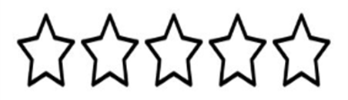
The Mosslands School
Name:________________
Summer Reading Bingo
The Rules:
Book of less than 100 pages ______________________________________ | Book read to your pet or stuffed animal ___________________ ___________________ | Book set in a country you’ve never been to ______________________________________ | Book with a person's name in the title ______________________________________ | A book set in a different world/universe ______________________________________
A Comic Book or Graphic Novel ______________________________________ | Book with a female lead character ______________________________________ | Book your parent/carer read as a child ______________________________________ | An adventure book ______________________________________ | A book you have read outside ______________________________________
The book you read in a pillow fort ______________________________________ | A historical book (fiction or non-fiction) ______________________________________ | FREE | Book recommended by a friend ______________________________________ | Read a book to a younger family member ______________________________________
A science fiction book ______________________________________ | A book you find challenging to read (you don’t have to finish it) ___________________ | The book you have read in bed ______________________________________ | A book that has been made into a tv series or film ___________________ | A book with a BAME lead character ______________________________________
A book that makes you laugh ______________________________________ | Book recommended by a teacher ______________________________________ | A biography ______________________________________ | An article from a magazine ______________________________________ | A story you have written yourself ______________________________________
Pick a square and once you’ve read the type of book listed, add the book title to that square.
In the same square, rate the book you have read by shading in the stars (1 star means you didn’t like it, 5 stars means you loved it!)
Once you get a bingo line, in any direction, submit to the Library Classroom on Google Classroom or hand in to the librarian when we are back in school.
An accolade for every square
completed and a prize for a completed bingo line!

